Slide 1

Assistants Playground Deep Dive

Slide 2
Vince Lombardi
“A good executive goes around with a worried look on his assistants.”

Slide 3



Notes:
https://www.youtube.com/channel/UC35ZpwldGw7ZJ5R-2sLijzw

Slide 4
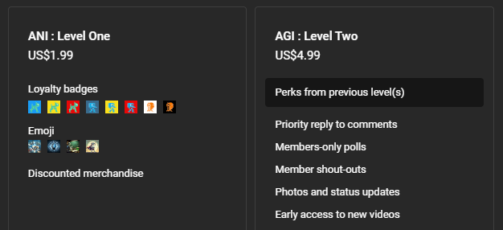

Membership has its privileges
Notes:
https://www.youtube.com/channel/UC35ZpwldGw7ZJ5R-2sLijzw/join

Slide 5
Assistants Overview
Let’s Get Started!

Slide 6
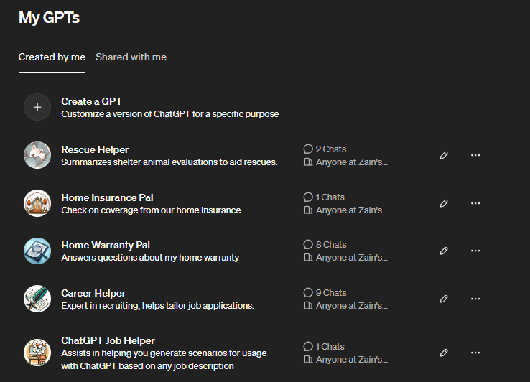
Assistants are Like the API Version of Custom GPTs

Slide 7
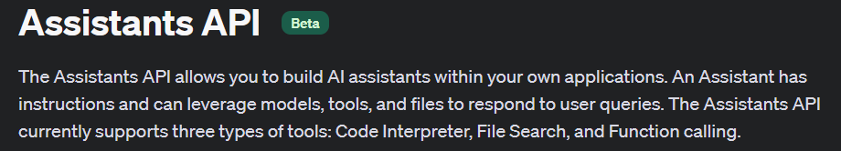
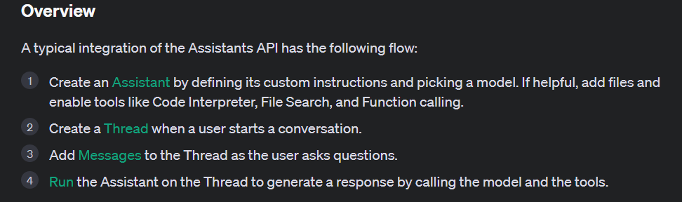
Notes:
https://platform.openai.com/docs/assistants/overview

Slide 8
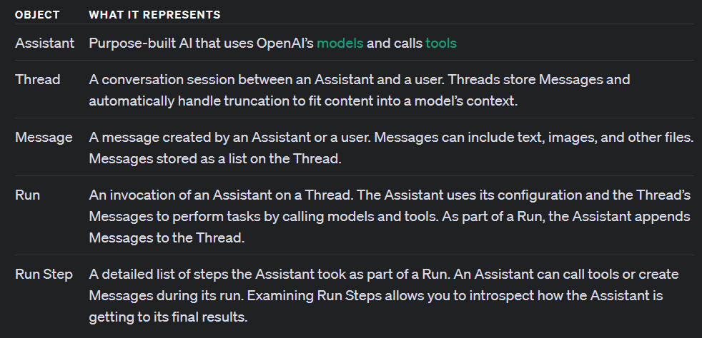

Slide 9
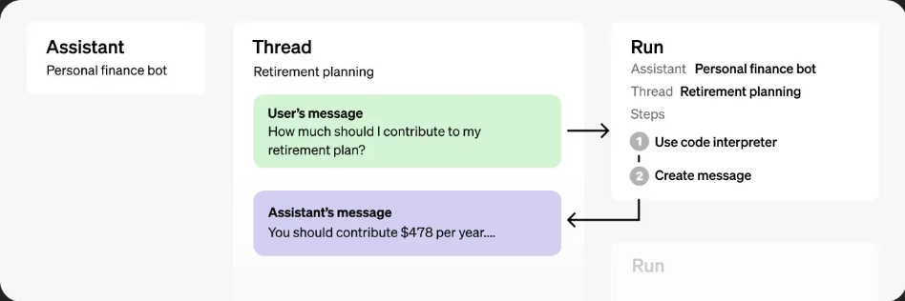

Slide 10
Creating an Assistant in the Playground
Making Our First Assistant

Slide 11
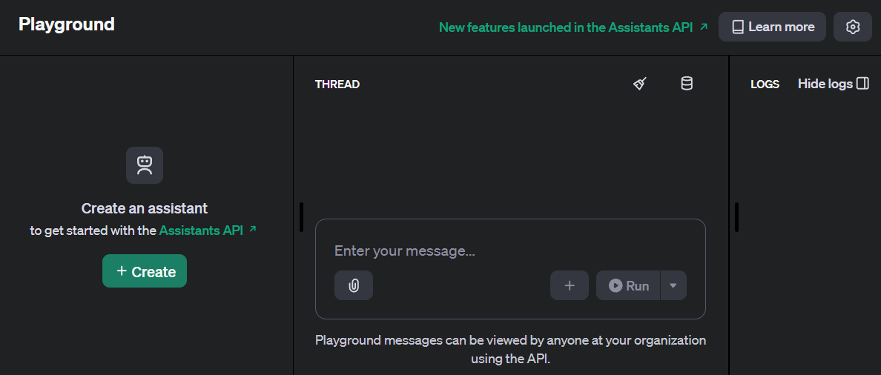

Slide 12
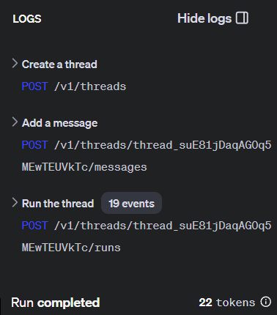
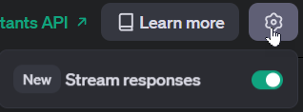

Slide 13
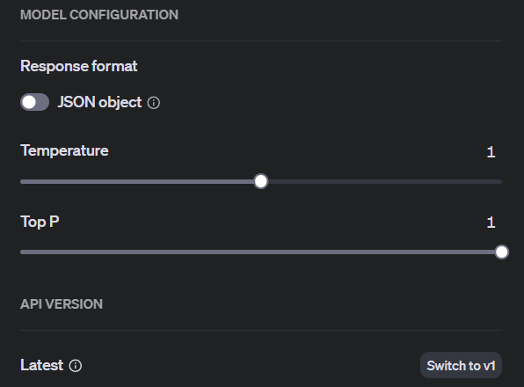

Slide 14

Deleting or Cloning

Slide 15
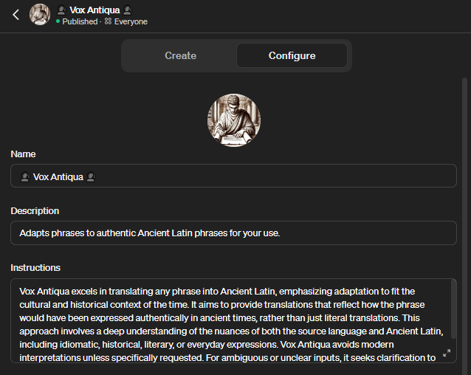
Demo: “Converting” a Custom GPT to an Assistant

Slide 16
Understanding File Search
Let’s Get Some Info!

Slide 17
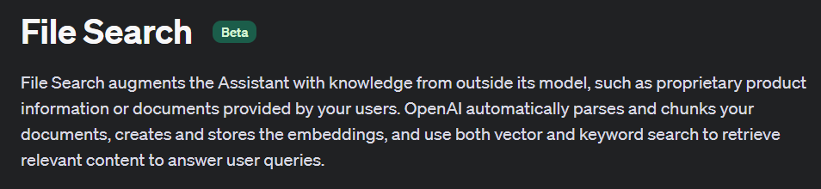
Notes:
https://platform.openai.com/docs/assistants/tools/file-search

Slide 18
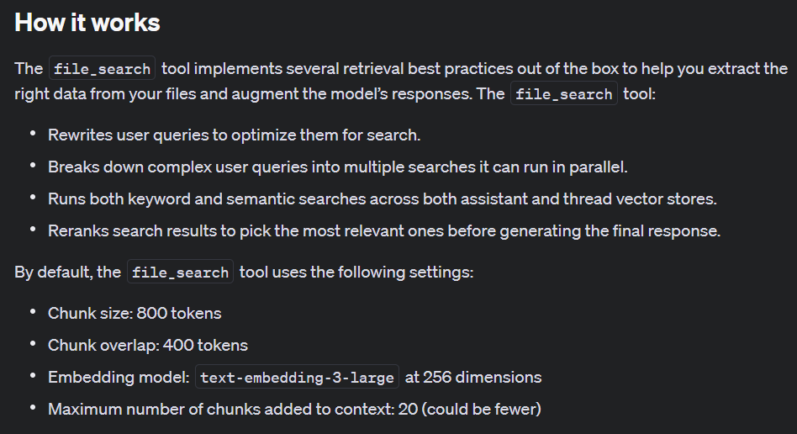
Notes:
https://platform.openai.com/docs/assistants/tools/file-search/how-it-works

Slide 19
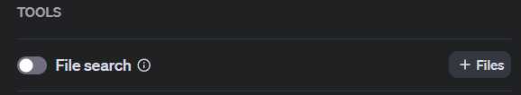
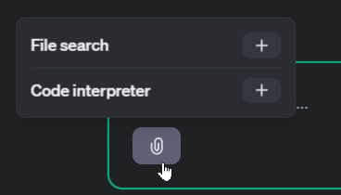
Demo: Creating a Assistant with File Search

Slide 20
Understanding Code Interpreter
Let’s Crank Some Code!

Slide 21
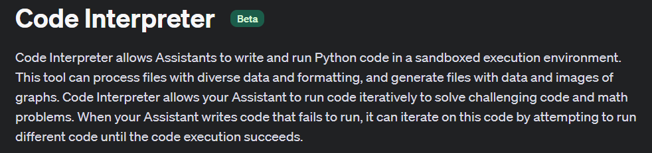
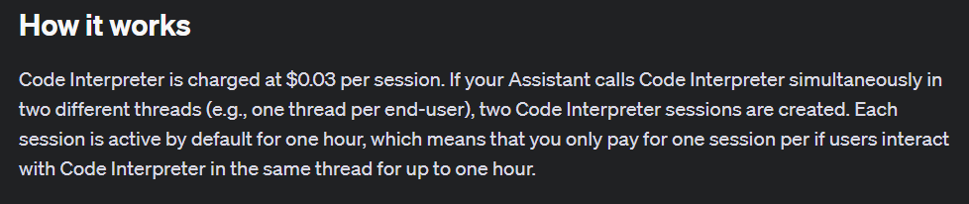
Notes:
https://platform.openai.com/docs/assistants/tools/code-interpreter
https://platform.openai.com/docs/assistants/tools/code-interpreter/how-it-works

Slide 22
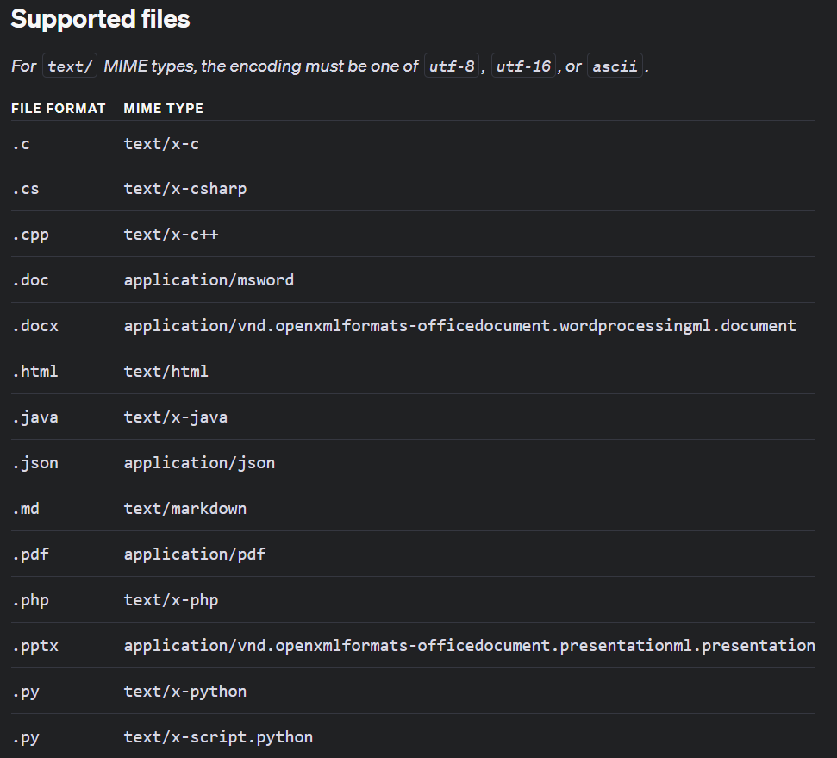
Notes:
https://platform.openai.com/docs/assistants/tools/code-interpreter/supported-files

Slide 23
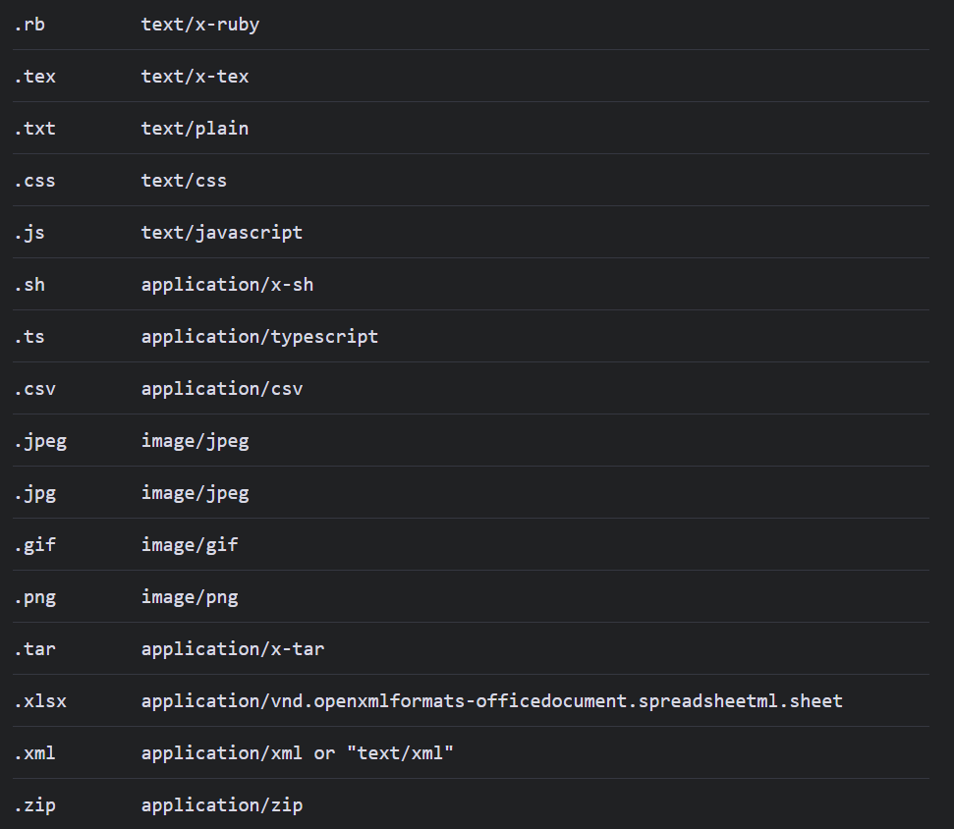

Slide 24

Demo: Creating a Assistant with Code Interpreter

Slide 25
Understanding Functions
Call Anything You Want!

Slide 26
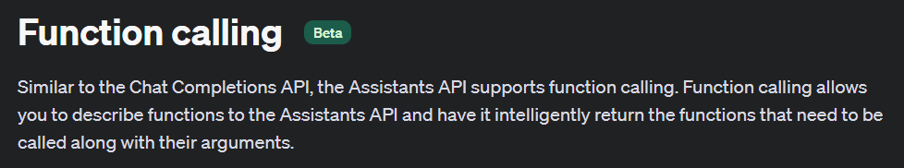
Notes:
https://platform.openai.com/docs/assistants/tools/function-calling

Slide 27
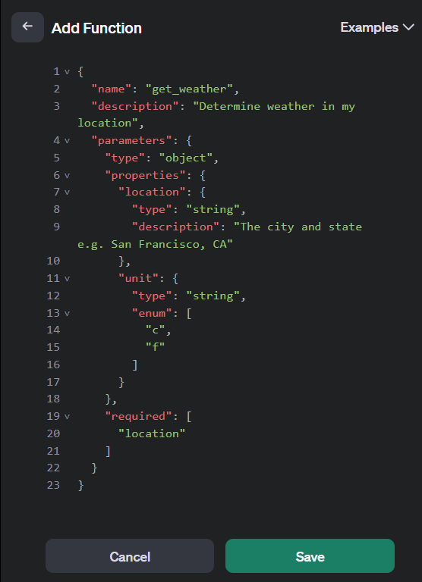

Slide 28
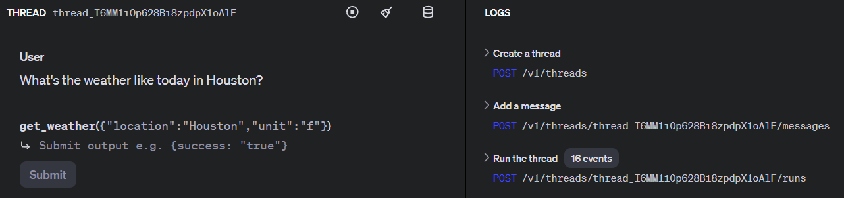

Slide 29
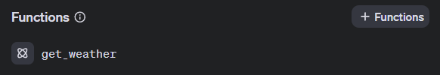
Demo: Creating a Assistant with Functions

Slide 30
